Slide 1
Assessing ozone abatement scenarios in the framework of the Spanish Ozone Mitigation Plan
Hervé Petetin¹, Marc Guevara¹, Roger Garatachea¹, Franco López¹, Kevin Oliveira¹, Santiago Enciso¹, Oriol Jorba¹, Xavier Querol², Jordi Massagué², Andrés Alastuey² and Carlos Pérez García-Pando¹
¹Barcelona Supercomputing Center, Earth Sciences department, Atmospheric Composition group
²Institute of Environmental Assessment and Water Research
12/05/2023
24th EMEP Task Force on Measurement and Modelling Meeting

Slide 2
Objectives
To assess the impact of abatement emission measures defined by the official national plan of energy and climate (PNIEC) and the national air pollution control program (PNCCA) on ozone levels in Spain
To explore additional abatement measures in key emission sectors (e.g. road transport, emissions from use of solvents, industry, aviation, shipping) to further mitigate ozone levels in Spain
Petetin et al. 2023 (submitted)
Notes:
In this contribution we describe the first assessment of ozone abatement scenarios performed to support the Spanish Ministry for the Ecological Transition and the Demographic Challenge (Ministerio para la Transición Ecológica y el Reto Demográfico, MITECO) in the design of the Spanish O3 Mitigation Plan.

Slide 3
Methodology

Slide 4
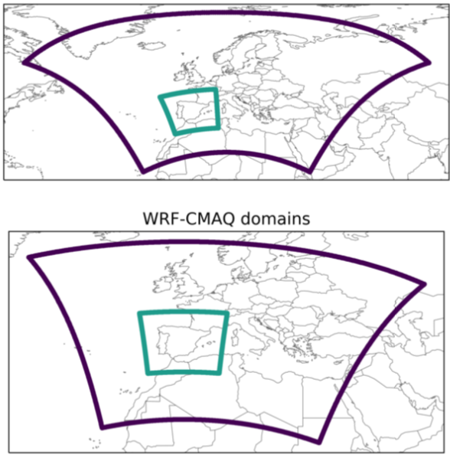
Air quality Models and setup
2 models (robustness in sensitivities and model uncertainty): WRF-CMAQ, MONARCH
Same anthropogenic emissions: CAMS-REG-ANT-v4.2 (Europe), HERMESv3 bottom-up (Spain)
Period of study July 2019
Model | CMAQ | MONARCH
Domains | Europe (12km)/Spain (4km) Lambert Conformal Conic | Europe (20km)/Spain (5km) Rotated latitude-longitude
 | 37 vertical layers (top 50 hPa) | 24 vertical layers (top 50 hPa)
Meteorology (BC) | WRFv3.5 (FNL) | NMMB (ERA5)
Chemistry (BC) | CMAQv5.0.2 CB05 + AERO6 (CAMS) | Online CB05 + BSC aerosols (CAMS)
Natural emissions | MEGAN (biogenic) | MEGAN (biogenic) + GFAS
CMAQ
MONARCH

Slide 5
Emission scenarios

Slide 6
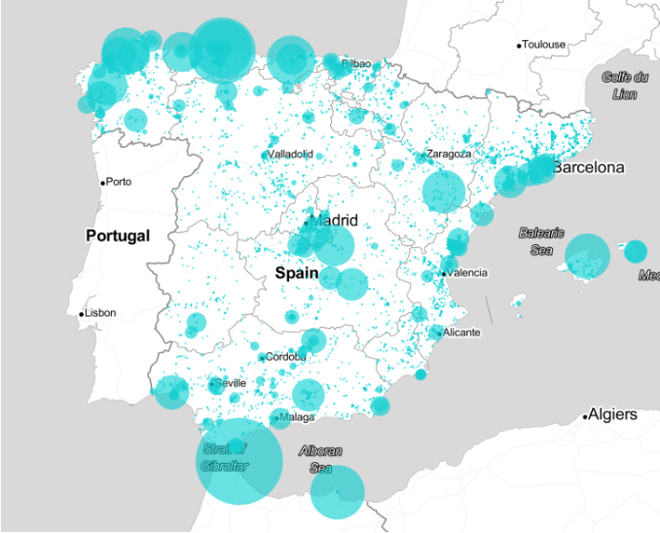
Base case (BE) anthropogenic emissions
Processing emission scenarios using HERMESv3 system
BE Base case scenario
Reference year 2019, combine HERMESv3 (BSC bottom-up emissions for Spain)
+
Spanish Emission Inventory MITECO (energy and manufacturing industry - Large Point Sources, Pollutant Release and Transfer Register-Spain -, fleet composition and official use of solvents)
+
CAMS-REG (rest Europe, shipping emissions)
NOx emissions of large point sources
NOx emissions (t/yr)

Slide 7
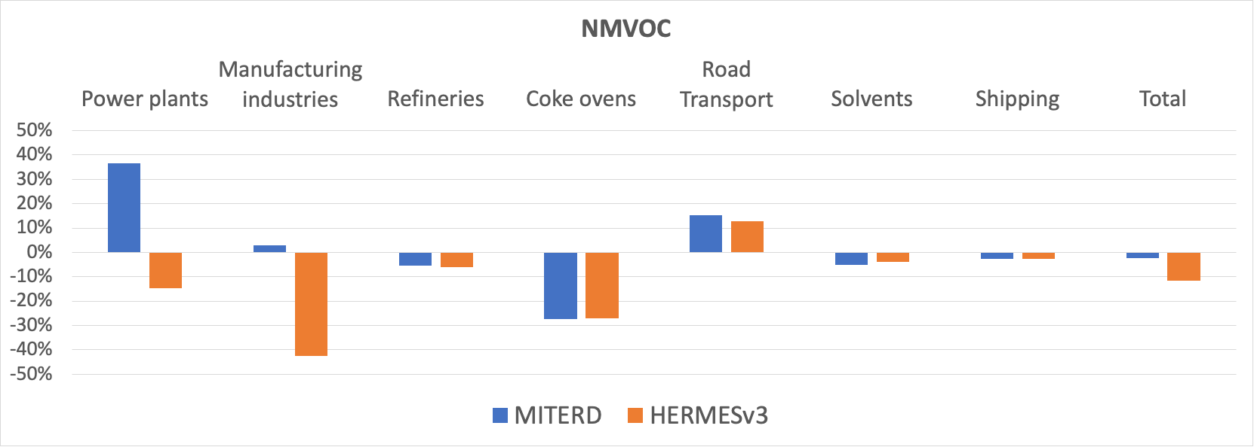
Planned emission scenario (PE)
Processing emission scenarios using HERMESv3 system
BE Base case scenario
PE Planned emission scenario
BE + emission changes projected for 2030 according to measures proposed in PNIEC and PNCCA plans of Spain (consistent with projected data 2030 CLRTAP)
!
Lack of information to distribute expected increase of NMVOC emissions from future biomass power plants
NMVOCs emission difference (%) between MITERD and HERMESv3
Notes:
official national plan of energy and climate (PNIEC)
national air pollution control program (PNCCA)

Slide 8
Specific scenarios
Emission reduction
(reference EB)
E(NOx) E(VOCs)
-37.0% -4.9%
-23.1% -5.1%
-37.0% -18.1%
-38.8% -5.0%
-38.3%* -5.0%*
-40.4%* -5.2%*
Processing emission scenarios using HERMESv3 system
BE Base case scenario
PE Planned emission scenario
Specific scenarios:
EE_T50 PE with lower reductions in road transport (-30% instead -60%)
EE_S25 PE with higher reductions in use of solvents (-25%)
EE_I25 PE with higher reductions in industry (-25%)
EE_A25_M20 PE with higher reductions in aviation (-25%) and shipping (-20%)
EE_A25_M60 PE with higher reductions in aviation (-25%) and shipping (-60%)
(less ambitious than PE)
(more ambitious than PE)
*excluding international shipping

Slide 9
Results

Slide 10
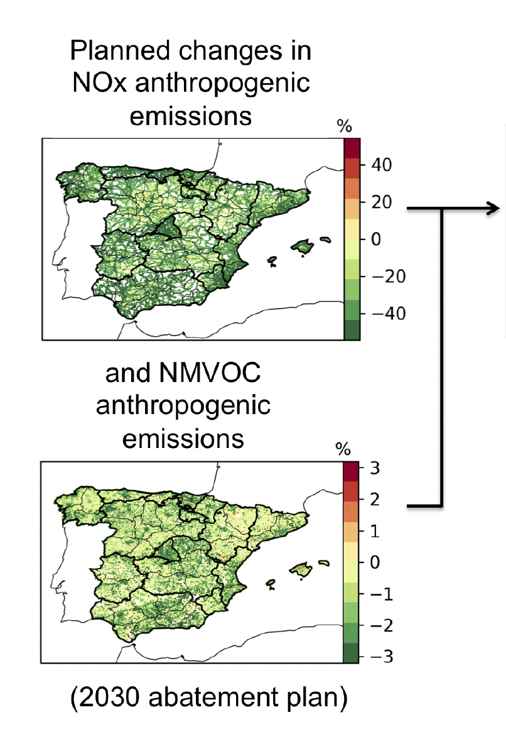
Planned scenario vs Base case scenario
Expected change in hourly mean O₃ in July 2019
BE-PE (μg/m³)
mean -2.4/-2.4
min -68.4/-51.0
max 89.2/42.5
BE-PE (μg/m³)
mean -3.8/-4.0
min -26.9/-44.5
max 29.4/13.7
Expected change in daily 8-hour max O₃ in July 2019
Consistent results between the two models, more robust conclusions
!
Statistically significant?
YES
NO
Notes:
Reductions in O₃ surface concentrations over most of the country, but with increases in some cities (less titration)

Slide 11
Planned scenario vs Base case scenario
Titration effect more relevant in some coastal cities
Mean daily profile: O₃ increase during the early morning compensated by a decrease in the afternoon in Madrid city but not in Barcelona city

Slide 12
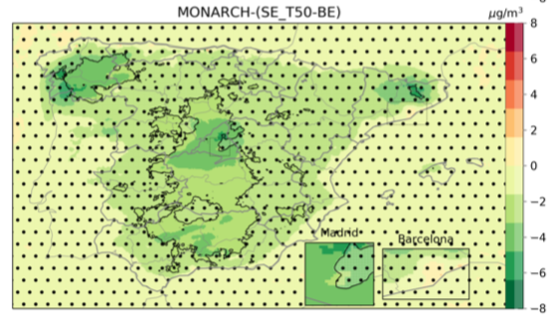
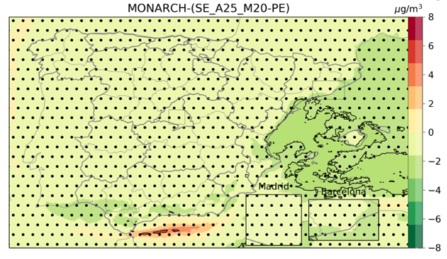
Specific scenarios
Mean difference O₃ (MD8h) July 2019
Statistically significant?
YES
NO
SE_T50 : -30% instead of -60% reduction of road transport PE
Achieving only half the objective of reduction of road transport emissions implies achieving only 50-60% of the O₃ reductions expected with PE.
Road transport is the key sector for achieving generalized reduction of O₃ in Spain.
SE_S25: -25% reduction of emissions from use of solvents
Limited and localized impact
Main benefit in slight attenuation of O₃ increase in Barcelona metropolitan area
Weak impact could be due to uncertainties in NMVOC emissions or limited reduction compared with -60% NOx in PE
*Different colorbar range
SE_I25: -25% industry emissions
Limited impact downwind areas where industry emission reductions occur (e.g., Castellón, País Vasco) with some reductions in O₃
*Different colorbar range
SE_A25_M20: -25% aviation and -20% shipping
Substantial reduction of O₃ in specific coastal areas (up to a few 100 km in-land) on the south-eastern Spain
O₃ increases in the Gibraltar shipping route (reduced titration)
Reducing aviation emissions does not result in any significant impact

Slide 13
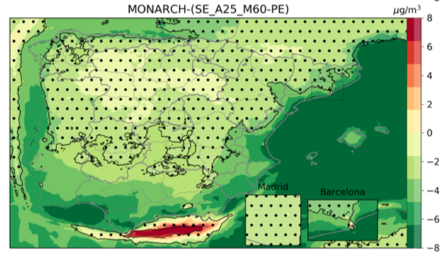
Specific scenarios
Mean difference O₃ (MD8h) July 2019
Statistically significant?
YES
NO
SE_T50 : -30% instead of -60% reduction of road transport PE
Achieving only half the objective of reduction of road transport emissions implies achieving only 50-60% of the O₃ reductions expected with PE.
Road transport is the key sector for achieving generalized reduction of O₃ in Spain.
SE_S25: -25% reduction of emissions from use of solvents
Limited and localized impact
Main benefit in slight attenuation of O₃ increase in Barcelona metropolitan area
Weak impact could be due to uncertainties in NMVOC emissions or limited reduction compared with -60% NOx in PE
*Different colorbar range
SE_I25: -25% industry emissions
Limited impact downwind areas where industry emission reductions occur (e.g., Castellón, País Vasco) with some reductions in O₃
*Different colorbar range
SE_A25_M60: -25% aviation and -60% shipping
More ambitious reduction of shipping emissions achieve stronger reductions in O₃ with major changes over the Mediterranean coast up to 300 km in-land

Slide 14
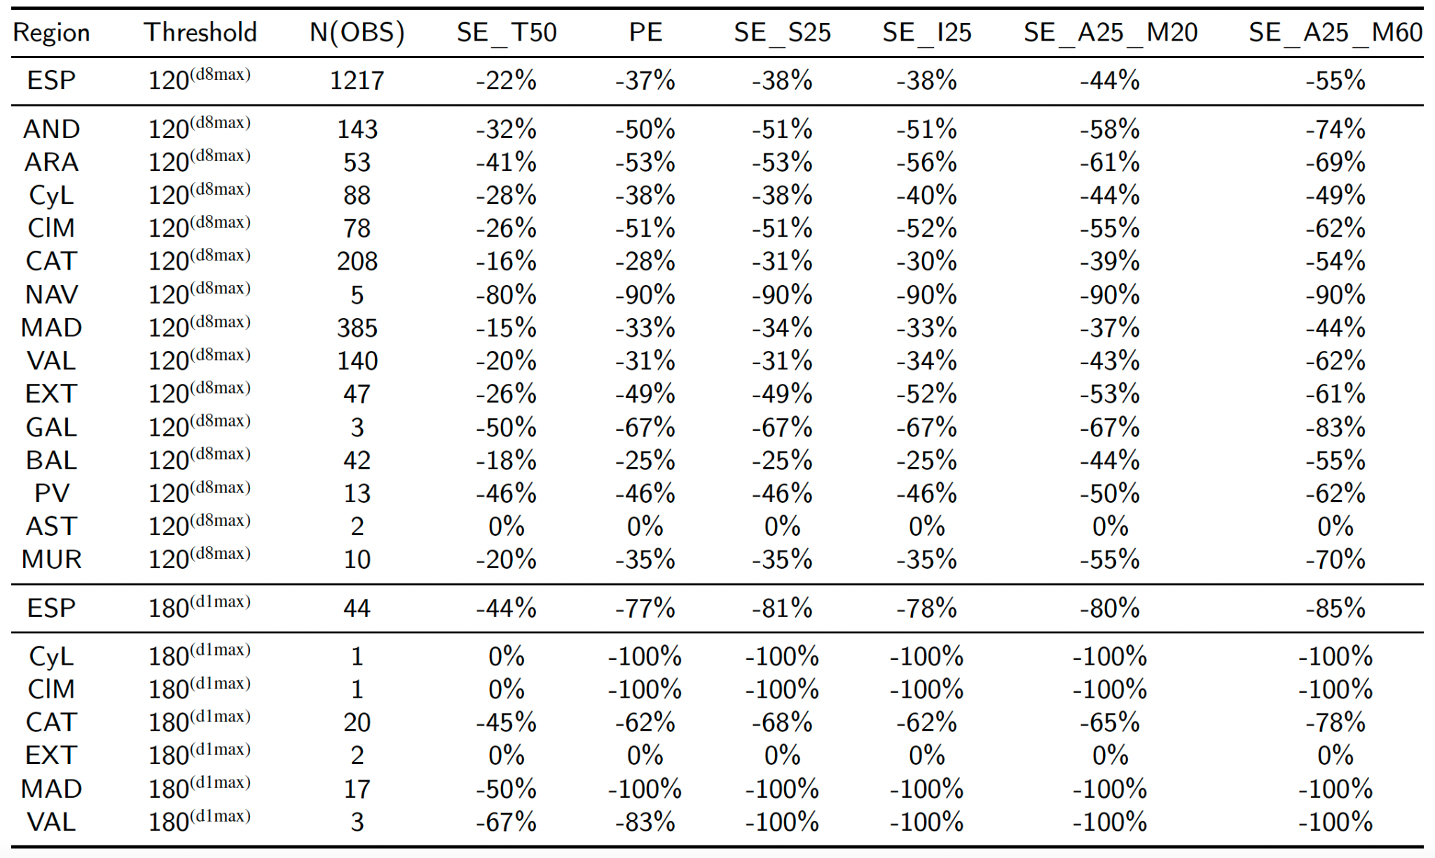
Impact on the number of daily exceedances
Applying the model-based relative change of O₃ concentrations to the observations:
Days with O₃(MD8h) > 120 𝛍g/m3: -37% reduction (-55% with strong abatement of maritime sector)
Days with O₃(h) > 180 𝛍g/m3: -77% reduction (-85% with strong abatement of maritime sector)

Slide 15
Conclusions
The Planned emission scenario (PE) allows a strong reduction of O₃(MD8h) of -4 𝛍g/m³ on average and we estimate -37% reduction of daily exceedances.
Road transport sector is a key emission sector for achieving the generalized reduction of O₃ over Spain.
The second key sector appears to be the maritime emissions with major impacts in coastal areas (up to 100s km in-land).
The implementation of a NECA zone in the Mediterranean Sea should be considered in the future to help controlling shipping NOx emissions in this O₃ hotspot region.
More limited and localized response is found in the other specific scenarios, including the reduction of solvent, industry and aviation.
Additional ambitious reductions of NMVOC emissions could compensate the increase of O₃ in urban regions.

Slide 16
Ongoing and future works

Slide 17
Advancing the current knowledge on NMVOC
Updating and improving NMVOC emission speciation profiles (Oliveira et al., 2023)¹
Compilation and comparison of speciation profiles available from databases/literature
Speciation of NMVOC anthropogenic emissions (150 activities, more than 900 species)
Intercomparison of the NMVOC speciated inventories (HERMESv3 versus CAMS-REG)
Evaluating MONARCH performance in simulating Benzene, Toluene and Xylene (work in progress)
Modelled versus observed concentrations using the national observational network
Review of emissions, temporal profiles, spatial proxies,...based on evaluation results
Performance of sensitivity tests (e.g., PRTR versus LPS NMVOC emissions in refineries)
^{1.} K. Oliveira, M. Guevara, O. Jorba, X. Querol, C. P. García-Pando, A new NMVOC speciated inventory for a reactivity-based approach to support ozone control strategies in Spain, Science of The Total Environment (2023) 161449.https://doi.org/10.1016/j.scitotenv.2023.161449

Slide 18
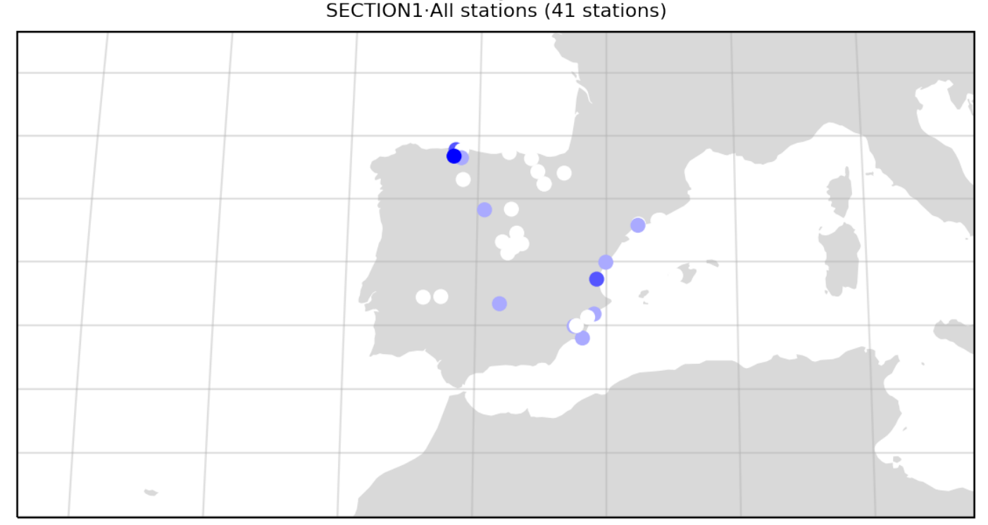
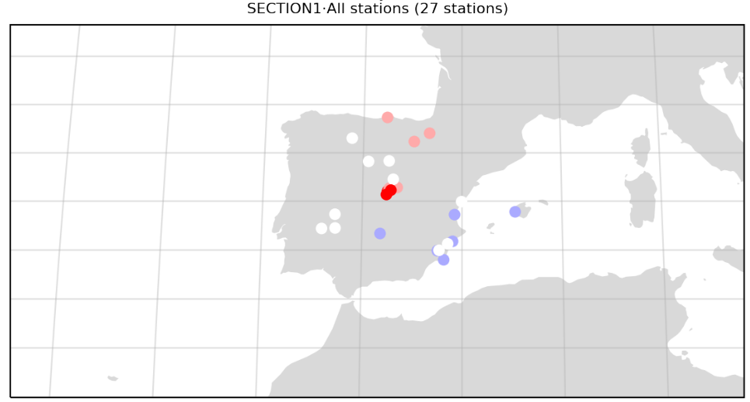
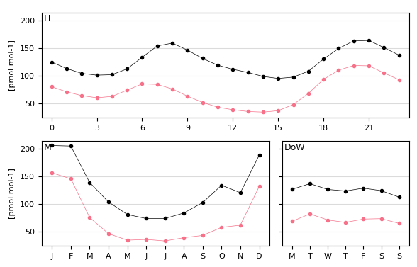
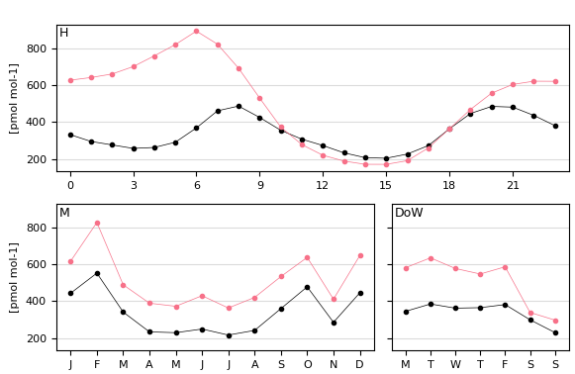
VOC evaluation
Benzene
Toluene
Arcelormittal
(Steel facility)
Refineries
Good correlation
Biases in industrial areas
N | NMB | NME | RMSE | r
41 | -43.0 | 47.5 | 69.58 | 0.83
N | NMB | NME | RMSE | r
27 | 41.9 | 64.0 | 311.2 | 0.67
Issues in speciation profiles (paint application)
Notes:
For benzene the correlation is good and we are reproducing all the cycles well, the only problem is the bias. The biggest bias is for industrial stations. We found out that the stations near refineries are highly underestimated and after comparing the official data from the ministry against PRTR, we performed a sensibility test which confirms it. For the station near Arcelormittal we are probably missing an activity and/or the emissions are underestimated (although comparing with PRTR it doesn't seems so).
For toluene we are performing well in all stations except in Madrid and in the north, where we are overestimating a lot. We just find out that it could be a speciation problem for the profile we are using for paint application activities, and to a minor extent an allocation problem caused by the proxy we are using for some sectors.
Finally you can mention that we will also evaluate Xylenes.

Slide 19
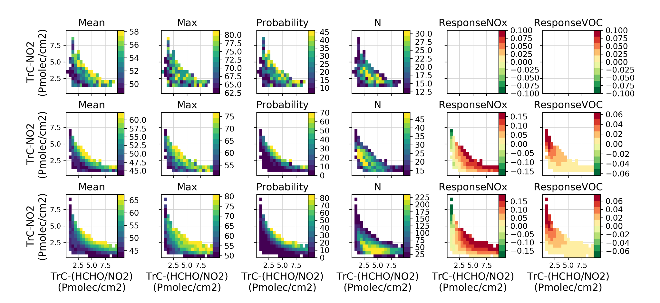
O₃ sensitivity regimes
Evaluating the O₃ sensitivity regime with TROPOMI HCHO and NO₂ observations (MITIGATE project)
Probability of high surface O3 against TrC-NO2 and TrC-HCHO in Madrid region, in observations and MONARCH
Observations
Model (collocated with observations)
Model (full sampling)

Slide 20
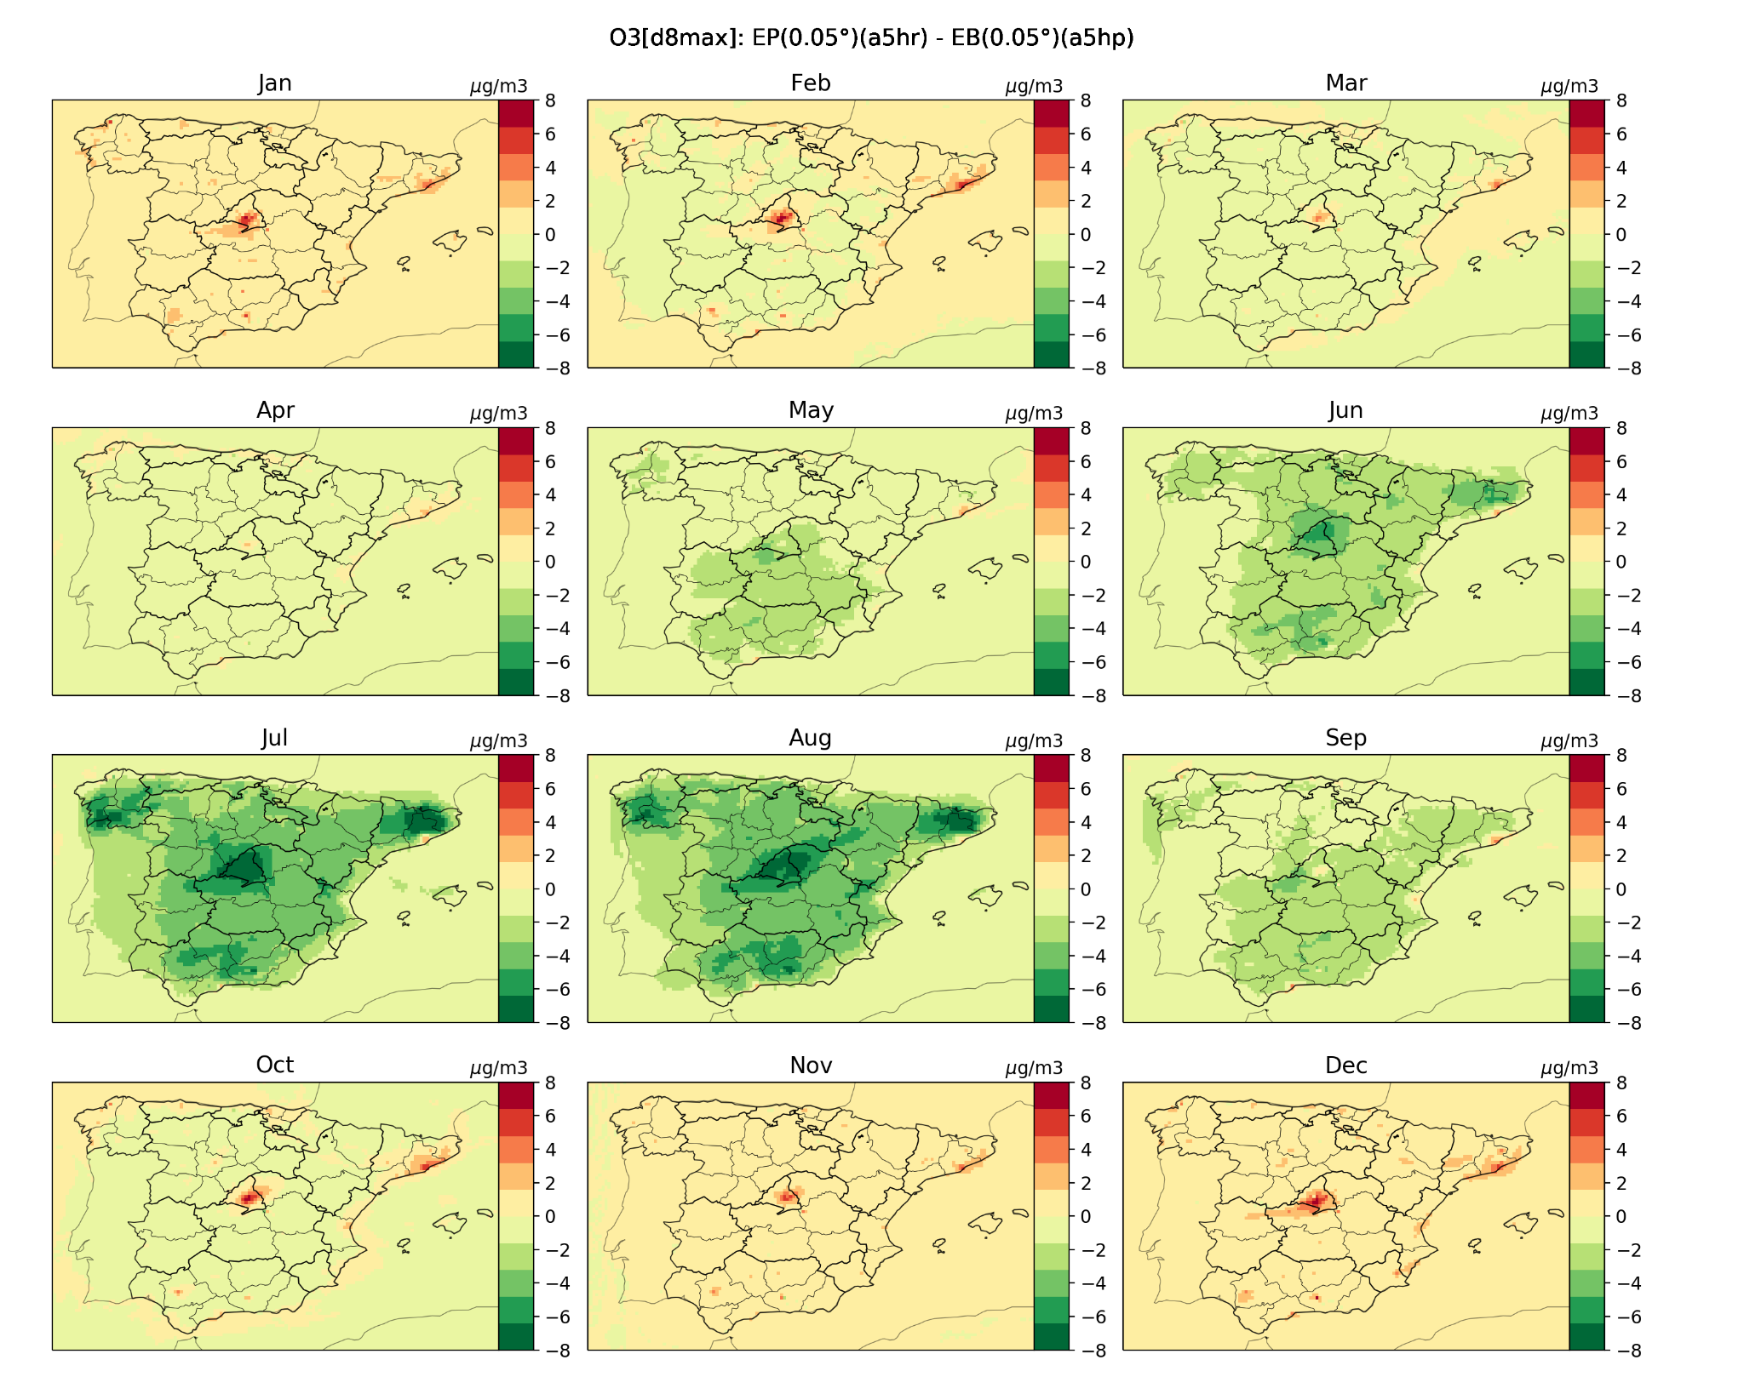
Future works
Improve Base case emission inventory:
Biomass burning sources (e.g. agricultural waste burning, wildfires)
Emissions from manufacture of organic chemistry products
Production, transportation and storage of fossil fuels and fugitive emissions during vehicle refueling at gas stations
Update NMVOCs speciation based on Oliveira et al. (2023)
Design of new specific scenarios (e.g. combination of previous ones, stronger reduction of NMVOCs)
Extend the analysis to the full annual cycle.

Slide 21
Thank you!
This work is supported by the Ministerio para la Transición Ecológica y el Reto Demográfico.
oriol.jorba@bsc.es

